Slide 1
Sample Use Cases for the DataDictionary View in DDI Views (DDI4)
Dan Gillman, Arofan Gregory, Larry Hoyle, Knut Wenzig

Slide 2
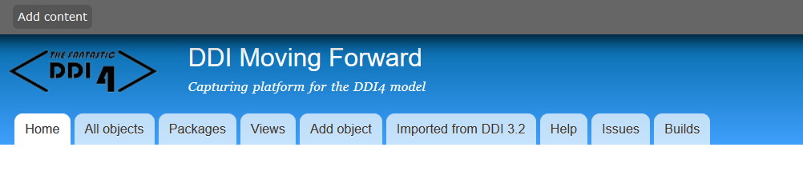
DDI Views - http://lion.ddialliance.org/
DDIViews (DDI4) has Functional Views, which are subsets of the whole model,
typically many fewer classes
All Functional Views are compatible

Slide 3
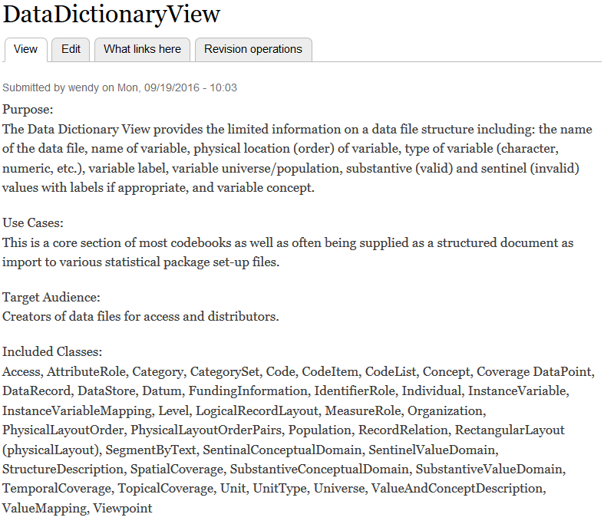
DataDictionary Functional View
Focuses on physical file structure

Slide 4
Classes in the DataDictionary Functional View
Access
AttributeRole
Category
CategorySet
Code
CodeItem
CodeList
Concept
Coverage
DataPoint
DataRecord
DataStore
Datum
FundingInformation
IdentifierRole
Individual
InstanceVariable
InstanceVariableMapping
Level
LogicalRecordLayout
Machine
MeasureRole
Organization
PhysicalLayoutOrder
PhysicalLayoutOrderedPair
Population
RecordRelation
RectangularLayout
SegmentByText
SentinelConceptualDomain
SentinelValueDomain
SpatialCoverage
StructureDescription
SubstantiveConceptualDomain
SubstantiveValueDomain
TemporalCoverage
TopicalCoverage
Unit
UnitType
Universe
ValueAndConceptDescription
ValueMapping
Viewpoint
This view has 43 of the current 858 classes in Lion
Notes:
Lion does have a number of deprecated or unused classes though.

Slide 5
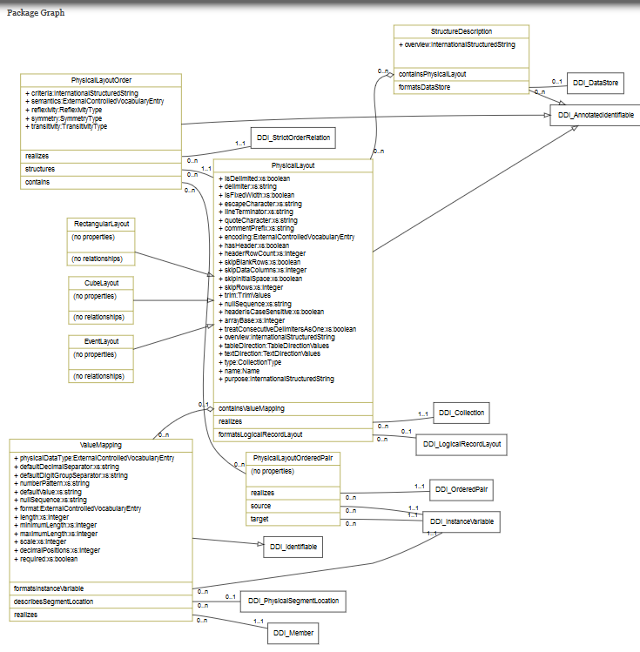
DDI-Views Packages (Example: FormatDescription)
Packages are useful when looking at, or developing, the overall model.
They are not namespaces.
Notes:
Packages divide up the large model into logically coherent parts. They are not reflected in the XML, RDF or other expressions of the model. This package is also a Pattern, a set of classes that are abstract and are “realized” by other classes. Realizing classes have all of the properties and relationships of the class they realize. Relationships connect to classes that may exist independently from the source class. Note that classes in a Functional View can make use of classes in other parts of the model.

Slide 6
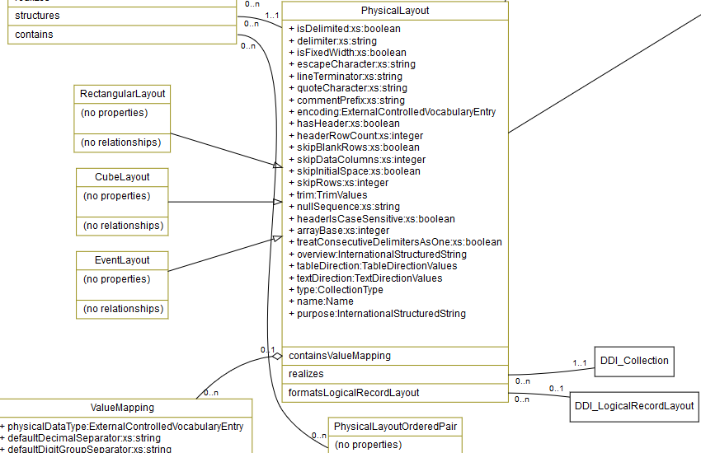
DDI-Views Packages (Example: FormatDescription Detail)
UML model features:
Inheritance
Realization
Properties
Relationships
  aggregations
  plain
Notes:
Packages divide up the large model into logically coherent parts. They are not reflected in the XML, RDF or other expressions of the model. This package is also a Pattern, a set of classes that are abstract and are “realized” by other classes. Realizing classes have all of the properties and relationships of the class they realize. Relationships connect to classes that may exist independently from the source class. Note that classes in a Functional View can make use of classes in other parts of the model.

Slide 7
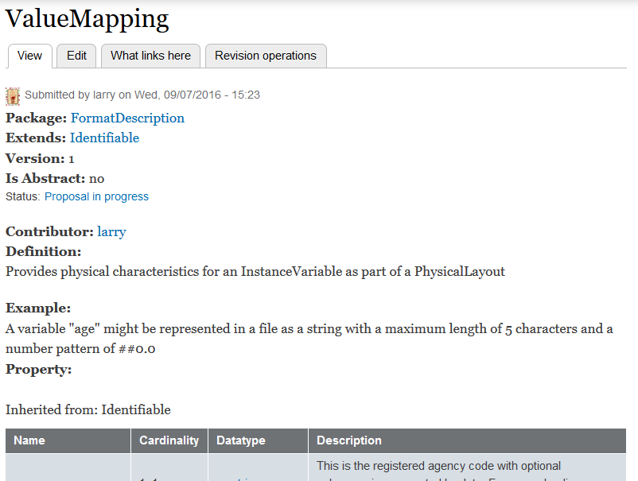
Describing a class in Lion – definition, notes, and examples
http://lion.ddialliance.org/ddiobjects/valuemapping
Notes:
Lion is a Drupal development environment for DDI-Views. Classes are entered via forms like the one shown above. They allow entry of general information about the class.

Slide 8
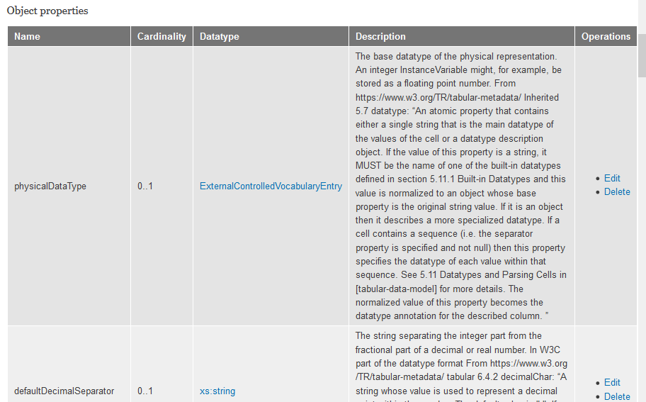
Describing a class in Lion – properties
Notes:
Lion forms also allow entry of information about properties and relationships, including description and cardinalities.

Slide 9
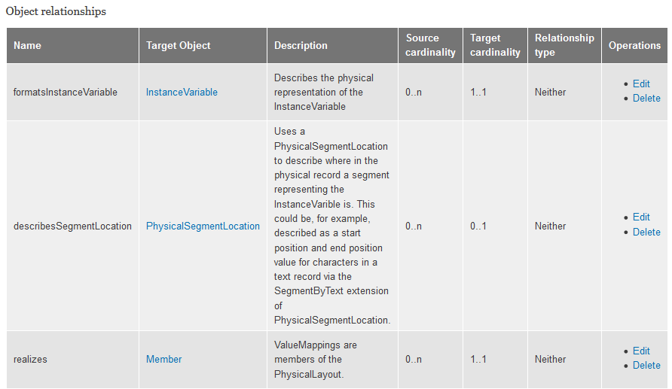
Describing a class in Lion – relationships
Notes:
Lion forms also allow entry of information about properties and relationships, including description and cardinalities.

Slide 10
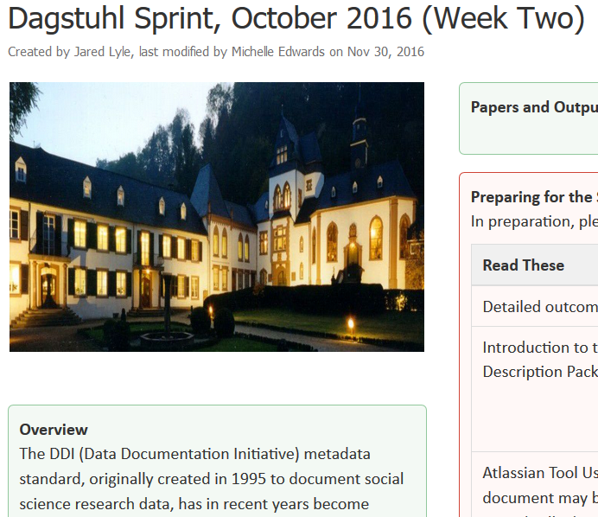
Dagstuhl Week 2 Sprint 2016 https://ddi-alliance.atlassian.net/wiki/pages/viewpage.action?pageId=39911463
Data Description working group
Tested the DataDescription View
Physical file layouts:
CSV Simple rectangular
Fixed Column rectangular
CSV Segmented
CSV Hierarchical
CSV Aggregate (ncube)
We also looked at event history data and think it will be describable with these elements too
see: https://ddi-alliance.atlassian.net/wiki/display/DDI4/Data+Description+View+Team
Notes:
There is a more detailed description of each of these cases on the Data Description Team site.

Slide 11
Event History Data
The event is the unit of observation
Examples
  A person visits a doctor: datasets holds all persons' id, date of visit and type of doctor; each row is a doctor's visit of a person
  A petrol station registers each car in case of refilling: dataset holds license plate number, date/time of refilling and amount of fuel
Additions to DDI needed for event data
  Which variable holds temporal information, which variable holds id of object with multiple events (see Viewpoint)
  A datatype of “pointer” or “reference”, the value of which is a DDI InstanceVariable or perhaps a ValueMapping

Slide 12
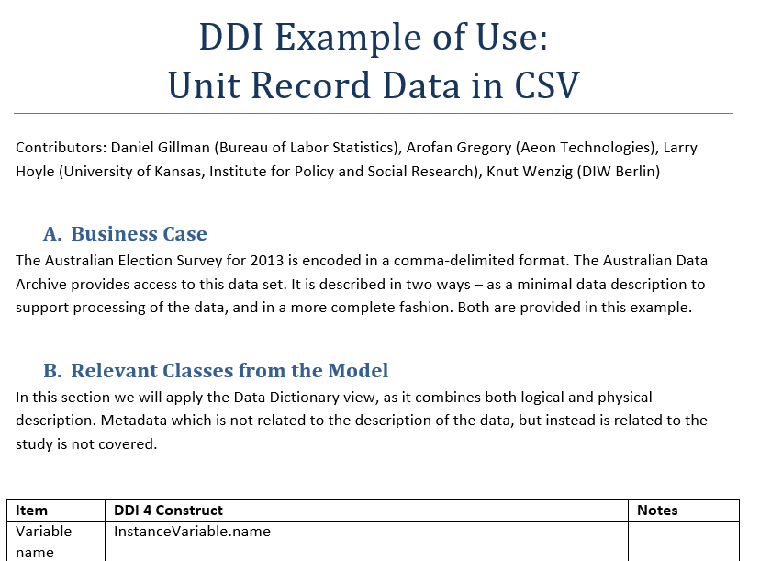
Simple Rectangular CSV https://ddi-alliance.atlassian.net/wiki/display/DDI4/Data+Description+View+Team
More details are available on the web in the report from the working group
Notes:
The CSV we created was an extract from the Australian Election Survey. The full dataset is available at: https://ddi-alliance.atlassian.net/wiki/download/attachments/39911463/DataDescriptionExamples.zip?api=v2

Slide 13
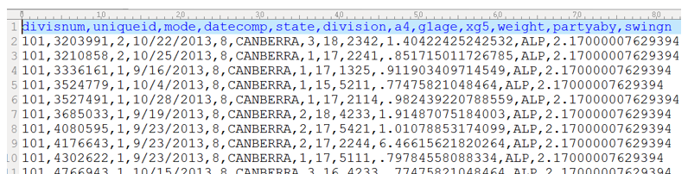
Simple Rectangular CSV – Australian Election Survey
The example uses a small representative set of variables
See: http://www.australianelectionstudy.org/about.html
Notes:
We selected a small subset of the variables in the AES for our example.

Slide 14
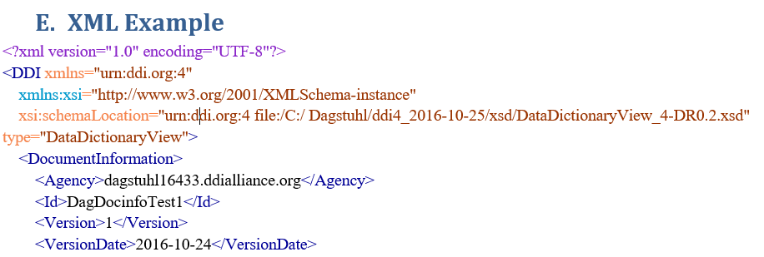
Example DDI4 XML

Slide 15
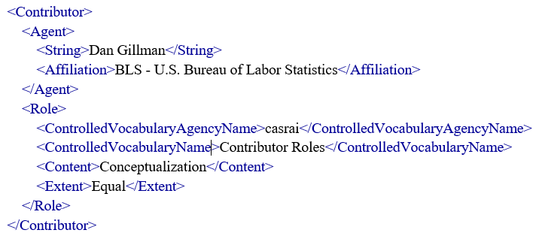
More XML

Slide 16
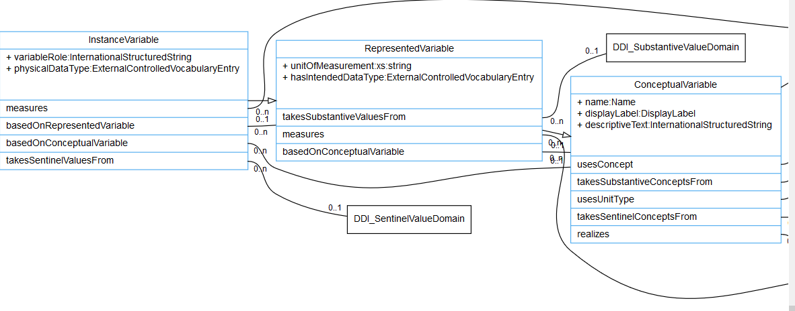
Variable Cascade in DDI http://lion.ddialliance.org/package/conceptual
The InstanceVariable can reference RepresentedVariable and ConceptualVariable
It also inherits all properties and relationships from them.

Slide 17
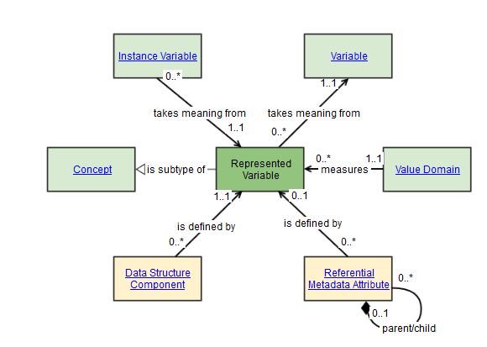
Modeled to comply with GSIM http://www1.unece.org/stat/platform/display/GSIMclick/Instance+Variable http://www1.unece.org/stat/platform/display/GSIMclick/Represented+Variable

Slide 18
Logical and physical records – at the record level
Logical
Physical
Variables
Logical variable order
LogicalRecord link
Physical variable order
Number physical records per logical
Encoding etc.
Record parameters (e.g. terminator)
Delimited?/delimiter, quote char …

Slide 19
Physical Records – at the variable level
Physical representation
  Datatype, decimal separator, group separator …
Location
  Starting position, ending position, length
  Record number

Slide 20
Describing a CSV
InstanceVariable
Logical
LogicalRecordLayout
Physical
ValueMapping
RectangularLayout
PhysicalLayoutOrder
Relationships
Notes:
The InstanceVariable and LogicalRecordLayout describe variables and their logical ordering. They contain a lot of logical level information. The ValueMapping, PhysicalLayoutOrder, and RectangularLayout (a kind of PhysicalRecordLayout) describe how data (associated with variables) are represented in physical media. The red arrows represent relationships among the classes. For the sharp eyed, see that the physical record is longer than the list of variable names.

Slide 21
Instance Variable - Properties And Relationships http://lion.ddialliance.org/ddiobjects/instancevariable
Agency
ID
Version
Name
DisplayLabel
DescriptiveText
ANNOTATION
UnitOfMeasurement
VariableRole
PhysicalDatatype
IntendedDatatype
SubstantiveConceptualDomain
SubstantiveValueDomain
SentinelConceptualDomain
SentinelValueDomain
Concept
UnitType
Universe
Population
ConceptualVariable
RepresentedVariable
ExternalMaterial
Notes:
The InstanceVariable has a combination of logical and physical elements, but no detail on physical layout of data records. This allows for refactoring of data files (e.g. from CSV to fixed column) while maintaining that the variables in the file are the same.

Slide 22
LogicalRecordLayout - Properties and Relationships http://lion.ddialliance.org/ddiobjects/logicalrecordlayout
Agency, Id, Version
Annotation
Type
Name
Purpose
InstanceVariable
ViewPoint
LogicalReordLayout
ExternalMaterial
Realizes Collection
As a Collection the LogicalRecordLayout
allows for ordering InstanceVariables within the Record.
Viewpoints allow assigning roles to InstanceVariables – Identifiers, Measures, or Attributes.
Notes:
The logical description of the record includes information like the order of variables in a record.

Slide 23
RectangularLayout (PhysicalLayout) - Properties and Relationships http://lion.ddialliance.org/ddiobjects/physicallayout
Agency, ID, Version
Annotation
IsDelimited
Delimiter
IsFixedWidth
EscapeCharacter
LineTerminator
QuoteCharacter
CommentPrefix
Encoding
Header
HeaderRowCount
SkipBankRows
SkipDataColumns
SkipInitialSpace
SkipRows
Trim
NullSequence
HeaderIsCaseSensitive
ArrayBase
TreatConsecutiveDelimitersAsOne
Overview
TableDirection
TextDirection
Type
Name
Purpose
ExternalMaterial
ValueMapping
LogicalRecordLayout
Realizes Collection
Notes:
The PhysicalLayout has a description of the physical layout of the data represented in a file. We tried to be compatible with the W3C Tabular Layout Model. https://www.w3.org/TR/tabular-data-model/

Slide 24
ValueMapping - Properties and Relationships http://lion.ddialliance.org/ddiobjects/valuemapping
Agency, Id, Version
PhysicalDatatype
DefaultDecimalSeparator
DefaultDigitalGroupSeparator
NumberPattern
DefaultValue
NullSequence
Format
Length
MinimumLength
MaximumLength
Scale
DecimalPositions
Required
ExternalMaterial
InstanceVariable
PhysicalSegmentLocation
  (e.g. Start, end, length)
Notes:
A ValueMapping indicates how an InstanceVariable is actually represented (e.g as a text string in a CSV). This is the most “physical” level of the description of the data in a data store (e.g. a file).

Slide 25
PhysicalLayoutOrder - Properties and Relationships http://lion.ddialliance.org/ddiobjects/valuemapping
Order Criteria (alphabetical, numerical …)
Semantics (before)
Reflexivity (Anti-Reflexive – a variable is not before itself)
Symmetry (Anti – A before B means B not before A)
Transitivity(
Transitive (if A before B and B before C then A before C)
PhysicalLayout it structures
PhysicalLayoutOrderedPairs
Notes:
A ValueMapping indicates how an InstanceVariable is actually represented (e.g as a text string in a CSV). This is the most “physical” level of the description of the data in a data store (e.g. a file).

Slide 26
PhysicalLayoutOrdedPair - Properties and Relationships http://lion.ddialliance.org/ddiobjects/valuemapping
Source InstanceVariable
Target InstanceVariable
The source variable is “before” the target variable.
The PhysicalLayoutOrder defined the semantic: “before”
Example:
divisnum before uniqueid
uniqueid before mode
…
Notes:
A ValueMapping indicates how an InstanceVariable is actually represented (e.g as a text string in a CSV). This is the most “physical” level of the description of the data in a data store (e.g. a file).

Slide 27
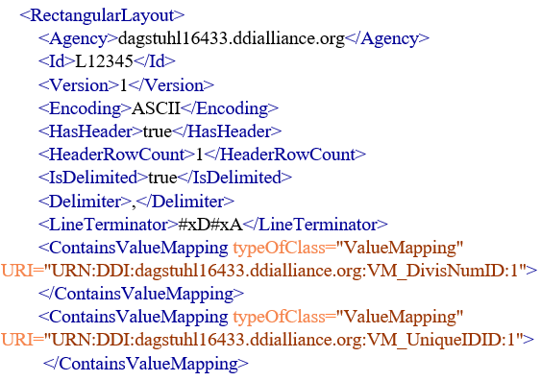
Typical CSV RectangularLayout in XML
Notes:
<RectangularLayout>
<Agency>dagstuhl16433.ddialliance.org</Agency>
<Id>L12345</Id>
<Version>1</Version>
<Encoding>ASCII</Encoding>
<HasHeader>true</HasHeader>
<HeaderRowCount>1</HeaderRowCount>
<IsDelimited>true</IsDelimited>
<Delimiter>,</Delimiter>
<LineTerminator>\n</LineTerminator>
<ContainsValueMapping typeOfClass="ValueMapping" URI="URN:DDI:dagstuhl16433.ddialliance.org:VM_DivisNumID:1"></ContainsValueMapping>
<ContainsValueMapping typeOfClass="ValueMapping" URI="URN:DDI:dagstuhl16433.ddialliance.org:VM_UniqueIDID:1"></ContainsValueMapping>

Slide 28
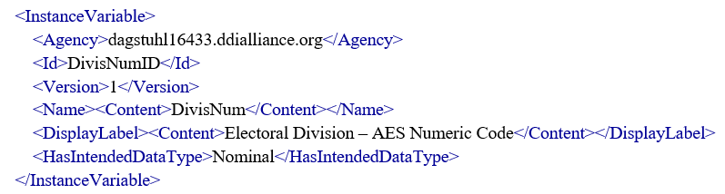
InstanceVariable for variable “DivisNum” in XML
Much more about the ValueDomain for DivisNum could be described with SubstantiveValueDomain and SentinelValueDomain
Actually an “ExternalControlledVocabularyEntry”
Notes:
HasIntendedDataType actually contains a reference to a controlled vocabulary entry.
<InstanceVariable>
<Agency>dagstuhl16433.ddialliance.org</Agency>
<Id>DivisNumID</Id>
<Version>1</Version>
<Name><Content>DivisNum</Content></Name>
<DisplayLabel><Content>Electoral Division – AES Numeric Code</Content></DisplayLabel>
<HasIntendedDataType>Nominal</HasIntendedDataType>
</InstanceVariable>

Slide 29
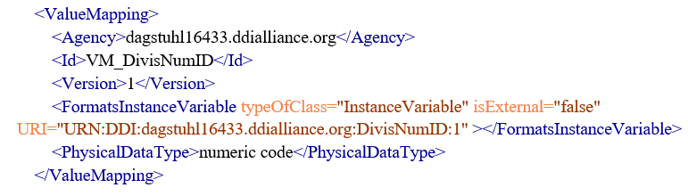
CSV ValueMapping for variable “DivisNum” in XML
Also an “ExternalControlledVocabularyEntry”
Notes:
<ValueMapping>
<Agency>dagstuhl16433.ddialliance.org</Agency>
<Id>VM_DivisNumID</Id>
<Version>1</Version>
<FormatsInstanceVariable typeOfClass="InstanceVariable" isExternal="false" URI="URN:DDI:dagstuhl16433.ddialliance.org:DivisNumID:1" ></FormatsInstanceVariable>
<PhysicalDataType>numeric code</PhysicalDataType>
</ValueMapping>

Slide 30
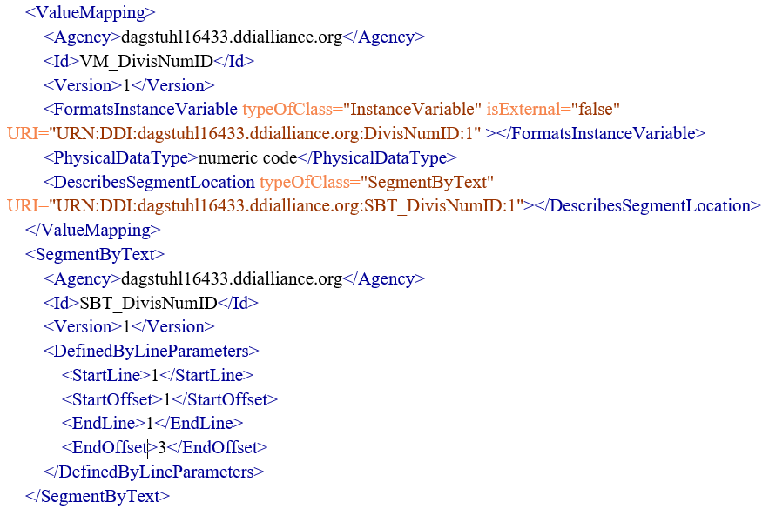
Fixed Layout ValueMapping for variable “DivisNum” in XML
Notes:
<ValueMapping>
<Agency>dagstuhl16433.ddialliance.org</Agency>
<Id>VM_DivisNumID</Id>
<Version>1</Version>
<FormatsInstanceVariable typeOfClass="InstanceVariable" isExternal="false" URI="URN:DDI:dagstuhl16433.ddialliance.org:DivisNumID:1" ></FormatsInstanceVariable>
<PhysicalDataType>numeric code</PhysicalDataType>
</ValueMapping>

Slide 31
Viewpoint http://lion.ddialliance.org/ddiobjects/viewpoint
Assigns one of three roles to variables:
  Identifier
  Measure
  Attribute
Useful for
  Aggregate data (ncubes)
  Event data (Which variable holds temporal information, which variable holds id of object with multiple events)
  Annotating variables (e.g. paradata)

