Slide 1
Communicating effectively with e-resources stakeholders
Angela Rathmel
Head of Acquisitions & Resource Sharing

Slide 2
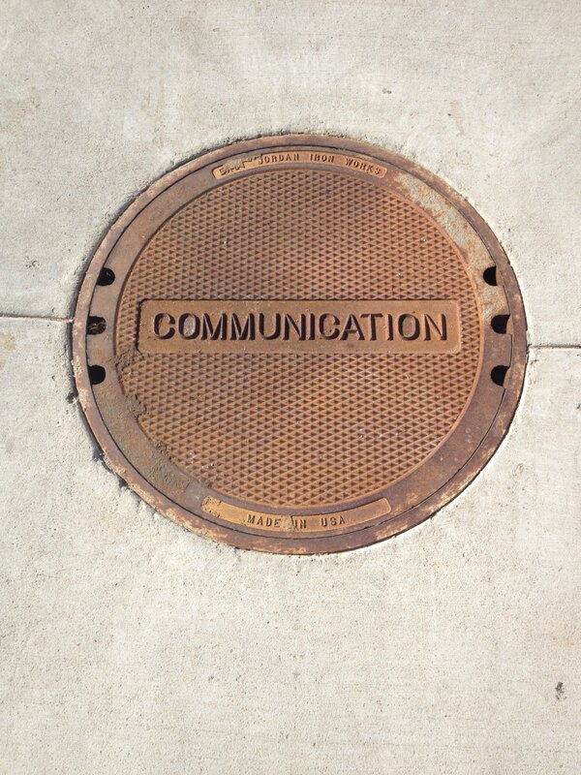
About me
Ambivert
Not always great at it
Grew better through music, teaching, psychology
Influenced professionally: Strengths and Vulnerability, Dervin.
Everyone his/her e-resource
Notes:
Because I think the biggest part about communication is the relational aspect and the stories we bring to each encounter, I want to start by telling you a little more about me. I have always been passionate about communication. I considered going into the communication field, but never connected with the predominant focus on broadcasting and public relations. I realize now this is probably because I’m what’s now called an ambivert – Myers Briggs-speak for part introvert, part extrovert. And this means that my passion for communication is also sometimes a struggle because I’m not naturally communicative and “outgoing” in the extroverted sense, and I tend to take more time thinking through what to communicate – which is great is many circumstances, but a challenge in the fast pace of e-resources librarianship.
I grew up learning to communicate in less traditional ways. My mom was a music teacher and an accountant, but during my teenage years, she decided to change careers, earning her Masters and doctorate to become a psychologist – so from her and in my own pursuit of music education as undergraduate, I learned to communicate through teaching and performing, and I also learned a lot about self-reflection, analysis, and communicating feelings. These influences shaped the personal and professional development in my career as a librarian and leader, particularly in the concepts of strengths (Marcus Buckingham research with the Gallup group) and the Brene Brown's research in vulnerability. In library school, I was very excited by the communication research of Brenda Dervin’s sense making which redefines communication from things being sent and received to rather a process of building meaning through experiences.
Finally, with a nod to Raganathan, I like to reemphasize what I’ve heard in multiples venues where the competencies are discussed, and which has been part of my own experience -- that these competencies cannot possibly describe the job requirements of a single e-resource librarian position. They are competencies of e-resources librarianship, and as such describe a team effort.

Slide 3

Teamwork
4.4. Demonstrating the ability to work collaboratively with other units and staff, establishing and maintain effective working relationships.
Notes:
And that is why I want to start with this competency first. I think it describes what e-resource librarianship looks like in the broadest terms. You will be working with others, learning from others, relying on others, and (hopefully) delegating to others. And those others will be very different people – different from you, and different from each other. These relationships take time to build, and lots of practice in all the other competencies of good communication.
The competencies related to communication are both specific to the work of e-resources and generalizable to overall good communication. But I think it was important to not take for granted communication in this work specifically, which might otherwise be characterized as purely technical or analytical.

Slide 4
Messaging and Empathy
4.1 Communicating effectively, promptly, and consistently, verbally and in writing, with a broad range of internal and external audiences: users, colleagues and staff, subscription agents, and vendors; the ERL must be able to tailor the message(s) to the circumstances and to the audience as needed. TAILOR THE MESSAGE
4.5 Demonstrating the ability to frame situations according to the others’ perspective to recruit assistance with troubleshooting from vendors, agents, consortium partners, IT support, student/faculty users, etc. EMPATHY
Notes:
4.1 Describes the specific communicative universe of this work and the practical goal of day-to-day communicating . Seems overwhelming doesn’t it? Look at all those different audiences! How do we do that?
While this is the first competency under communication, rather than seeing each of these linearly, I prefer to illustrate the symbiotic relationship among them. For example, showing 4.4 teamwork first speaks to the fact that establishing and maintaining relationships is how you eventually learn to figure out what messages work for which person, you learn how to draw out the real information need, and how to best provide for or request help. But the reverse is also true -- you have to start acting to establish those first lines of communication which build these different relationships.
Promptness (whether or not accompanied by substantive content) establishes trust that a person is at least being heard, and is especially important in communication that is not face-to-face. Consistent communication on your end builds also trust and expectations, so it is clear that there is a thinking, caring person behind that email, or that there might be something in writing following that verbal promise.
4.5 has the most to offer on the substance of how we go beyond promptness and consistency that allows us to effectively tailor a message. {CLICK} This require the skill of EMPATHY – seeing the others’ perspective.

Slide 5
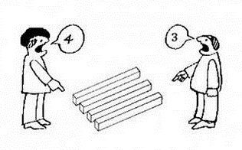
Empathy - How?
Active listening
Join committees
Smile, small talk
Reference desk shifts
Regular meetings
Img source | author and © unknown
Notes:
Developing empathy requires something I’m sure you probably heard many times as the key to good communication – ACTIVE LISTENING.
Some ways that we can practice listening and developing empathy is to just get out there with people. We may already have regular meeting with the people who speak our language, but there are opportunities to learn more about others and experience new individual and work perspectives by joining committees or service work.
But, whether new or the same old group interactions, some tips for practicing these skills can be as simple as not starting and ending the meeting time buried in your device. Greet people as they arrive, even with just a smile. All of these are basic reference desk practices that many of us just never had a chance to experience, but now do and can really benefit from.
Other opportunities I’ve had to practice building interactions in this way, are serving on the reference desk, or if not the physical desk, challenging myself and staff to go beyond just email referrals from the reference desk to using IM.
I’ve gotten much better over time at being available to people, responding to needs when they arise. But I constantly have to work at going out and seeking information from others. One way I do this by making regular meeting with people. And this doesn’t have to be the same for all. With some people its weekly for 30 minutes to an hour and a half, with others its monthly or even quarterly. It’s important to remember however, to find the balance where…{CLICK}

Slide 6
Less is more
4.2 Synthesizing [into] easy to understand summaries of complex and ambiguous phenomena. ERLs often serve as the library’s liaison with external stakeholders such as vendors or institutional information technology staff.
Notes:
Less is more. Especially with meetings, right? We don’t want to over do it. When I find myself spending so much time in meetings that I have no time to deliver on the actions from those meetings, it’s time to reassess.
This can also happen in day to day communication. There is certainly the tendency to over communicate when talking about e-resources, particular by wanting to provide all the details – and we know there are a lot of details at play -- about why the thing might not be available, the complexities of the perpetual access or particular purchase model, etc. The solution is not to eliminate these details, but to parse them to where they will be most relevant.
When research colleagues and I surveyed libraries about e-resources troubleshooting and development needs, beside technology literacy, there was the need for people to understand and communicate the big picture of e-resources. Trying to addressing a comfort with ambiguity, the responses to this survey suggest communicating more realistic expectations for the imperfection of e-resources generally.

Slide 7
Less is more - How?
Empathy, again.
Terminology, jargon
Questioning (Reference Interview) “Tell me more about that…”
Start small
Don’t bury the lead
Image: cover of "What Do You Mean" by Justin Bieber
Img source | Fair use of album cover art © Def Jam Recordings
Notes:
Empathy, again helps here. Being able to explain that there might not be clear cut solutions and acknowledging that this can be frustrating and confusing.
You often hear the warning to avoid jargon. This is necessary for us to get to that common language, and we do that through questioning. For example, “When you say X, what do you mean?” or “tell me more about that” [some work examples: You say tomato, I say tomato. (Voyager = Voyager Acquisitions or Voyager Circulation) -- “It’s messy until its not messy” -- “What does that mean? Oh, it means exactly what it says”]
Start small.. – this is why IM can be useful, because it forced you to frame the most necessary pieces of information and not overwhelm with all the possible things to try. You will quickly realize when this is not enough and you need to turn it into a phone or email referral.
Email, especially when delegating or directing, it’s important to put what you are wanting from that person or what you’re providing that person (how your meeting their need) right up front. Then, if you think its necessary, provide additional details. “If you curious…”

Slide 8
Just the facts, ma’am…
4.3 Explaining and instructing clearly and concisely, when and as needed; rises above personal feelings and frustrations in order to provide the best possible services and resources to end users.
INFORMATION MANAGMENT
4.7 Recognizing the need for data, selecting appropriate data analysis methods and utilizing data (e.g. resource usage statistics) persuasively to inform decision making.
Notes:
I think 4.3 is the most challenging, surprisingly not because of emotional baggage expressed here, but because of timing! HOW DO YOU KNOW WHEN? Triggers.
This is where the tools we use, and their ability to trigger actions have a critical role to play in communication. Do our tools help in making those moments more transparent. If we are only relying on email for this we are doing it WRONG. This goes hand in hand with management of information which allows that key data to be on hand at the moment it is needed. And to be able to separate out the wheat from the chaff.

Slide 9
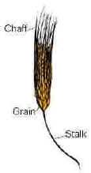
Information Management – How?
Improve email (personal task tracking, shared accounts)
Web forms
Ticketing systems
Spotlights vs Lobs (Feather, 2007).
Notes:
Going back to some of the communication tools my colleagues and I learned about in our troubleshooting survey. Librarians report:
Email is one of most reactive tools in our toolbox. But also the most popular. Some more proactive approaches to using email include adding in personal task tracking and, even better shared email accounts that allow proactively assign the best person to the task, multiple people to address problems means you can proactively plan for the certainty that messages will get answered and not lost in a personal email inbox. Web forms are improved when certain key pieces of data are included, like patron information (not anonymous), an ability to provide details of the problem. Customer Relationship Systems and Ticketing Systems (also underused according to the survey are additional tools that help track your relationships with patrons and incident, both in what was reported as well as workflow of making sure it was resolved efficiently and effectively. This is one of the ways reference desks have managed handoffs, and is a place where e-resources troubleshooting staff could take note.

Slide 10
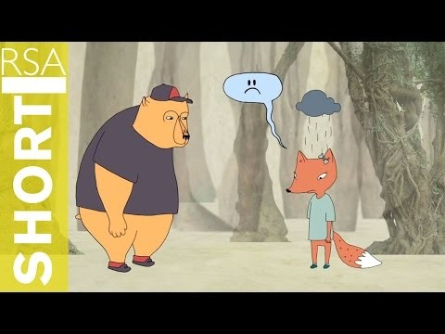
Other How?
Emotional Intelligence (for you), Empathy (for others)
Strengths
Facilitation, project management
Practice, practice, practice
https://youtu.be/1Evwgu369Jw
Brene Brown on Empathy
Notes:
I hope I’ve provided practical day to day examples of how we can continue become competent communicators. But overall I want to close by touching back on the benefits that Leadership training has had for me in learning these skills, particularly focused on learning more about yourself in order to see how you see others. You may find the challenge for e-resource librarians is that the communication and collaboration required may be different than how your organization is structured hierarchically or culturally to communicate and collaborate. You may see connections and strategic opportunities that are larger than what one position as an e-resources librarian, or a staff member on the reference desk, or a e-resource cataloger can influence to change. Understanding ourselves better opens up paths to see where we can be most effective. Emotional Intelligence and Strengths – building on what is working and using that to the competency needed.
Facilitation – learning how to listen and redirect communication is excellent practice in framing situations according to the others’ perspective (4.3) and being able to help people dialogue together to ask the questions that need to be asked. Whereas in the reference interview that happens with the user, for the e-resources librarian and staff this often happens in meetings or in projects. Project management has been another tool for developing communication competency. (Nod to next presentation) I have particularly found the practice of defining the project and breaking it down into actionable parts to be good practice in Synthesizing [into] easy to understand summaries of complex and ambiguous phenomena. (4.2)

Slide 11
How’d I do?
4.8. Making presentations that are clear and comprehensive.

Slide 12
Resources
Ingred Bens (2012). Facilitation at a glance! : your pocket guide to facilitation. Salem, NH: GOAL/QPC. http://www.worldcat.org/.../785065675&referer=brief_results
Brene Brown (2015). Rising strong. New York: Spiegel & Grau. http://www.worldcat.org/.../909776909&referer=brief_results
Brene Brown (2012). Daring greatly: how the courage to be vulnerable transforms the way we live, love, parent, and lead. New York: Gotham Press. http://www.worldcat.org/.../779263434
Marcus Buckingham (2007). Go put your strengths to work : 6 powerful steps to achieve outstanding performance. New York: Free Press. http://www.worldcat.org/.../77573917&referer=brief_results
Brenda Dervin, Lois Forman-Wernet, and Eric Lauterbach (2003). Sense-making methodology reader: selected writings of Brenda Dervin. Cresskill, N.J: Hampton Press http://www.worldcat.org/...51871729&referer=brief_results
Celeste Feather (2007). Electronic Resources Communication Management: a Strategy for Success. Library Resources & Technical Services, 51 (3). 213. http://search.proquest.com/docview/216899918
Angela Rathmel, Liisa Mobley, Buddy Pennington & Adam Chandler (2015). Tools, Techniques, and Training: Results of an E-Resources Troubleshooting Survey, Journal of Electronic Resources Librarianship, 27:2, 88-107 http://dx.doi.org/10.1080/1941126X.2015.1029398
Notes:
Resources list for staying up to date in handout. But, see also these key readings mentioned this presentation.

